Slide 1
A statistical Analysis OF Medicare PAYMENTS
Dilip Jagannathan Seshadri
Keith Rong
Andrew Yang

Slide 2


Overview
Medicare is a federal health insurance program for people 65 or older, younger people with disabilities, and people with end-stage Renal Disease
Medicare is divided into four parts
Part A: Hospital/Hospice Insurance
Part B: Medical Insurance (Outpatient care)
Part C: Medicare Advantage (All-in-one alternative to Original Medicare)
Part D: Prescription Drug Coverage
Funding for Medicare comes primarily from general revenues, payroll tax revenues, and premiums paid by beneficiaries

Slide 3

Overview Continued
Home Health Agencies aim to provide skilled care for treatment or rehabilitation services such as skilled nursing, physical and occupational therapy, social work, and home health aide to patients
Medicare reimburses home health agencies, who provide services directly to Medicare beneficiaries
Home health agencies file Low Utilization Payment Adjustment (LUPA) claims, as well as Non-LUPA claims to Medicare
LUPA claims = 4 or fewer visits are provided in a 60-day episode
Non LUPA claims = more than 4 billable visits are provided to a patient in a 60-day episode

Slide 4
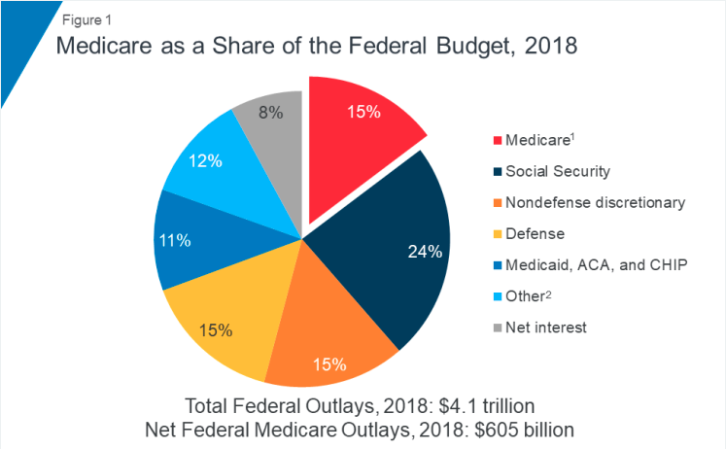
Medicare AS a SHARE OF the FEDERAL BUDGET, 2018
MedICARE PROJECTED ENROLLMENT, 2000-2050

Slide 5
The Problem
Medicare Costs
Non-LUPA Claims
Healthcare costs in the US are on the rise. In 2018, Medicare spending grew 6.4% to 750.2 billion.
Spending is expected to rise to 18% by 2029
Expected to experience the fastest spending growth due to the projected enrollment growth
Unlike LUPA claims, non-LUPA Medicare reimbursements do not follow a national standardized per visit payment discipline
Calculated based on the episodes and the patient characteristics for a 60-day period
Do not increase based on the number of billable visits for that specific medical episode
Question: What factors influence Medicare payments for Non-LUPA?

Slide 6
DataSET
Dataset from Centers for Medicare and Medicaid Services (CMS) presents summarized information on services provided to Medicare beneficiaries by home health agencies for the year 2016
Contains aggregated, annual payment claim information for Home Health Agencies
Contains data on non LUPA claims as well as LUPA claims
Does not contain information at the patient level but rather at the Home Health Agency level
10,139 total observations which were made up of 49 fields
Dependent Variable
Expected payment to Home Health Agency from Medicare for non-LUPA claims

Slide 7
EXPLORATORY DATA ANALYSIS
Identifiers eliminated from dataset (Provider ID, Agency, Address, City, State, ZipCode)
Other payments eliminated from dataset (LUPA related payments, Other charges)
Columns only used for reporting purposes eliminated (Demographic information like age, gender, race, ethnicity related columns)
Rows that has N/A and columns that have lot of N/A were eliminated
Dataset used for analysis after initial cleanup had 9,562 rows and 21 independent variables
Source: https://data.cms.gov/Medicare-Home-Health-Agency-HHA-/Medicare-Home-Health-Agency-HHA-Provider-Aggregate/fdg8-v2i5

Slide 8
MODEL BUILDING
First order model with all 21 independent variables
Based on low correlations (variation inflation factor) and high p-values (0.01 significance), 11 variables were eliminated
Highly correlated factors were tested one by one and distinct beneficiaries, percentage of asthma beneficiaries and percentage of copd beneficiaries were eliminated
Higher order models were tested with interactions and the final model was recommended

Slide 9
Significant PREDICTORS in FINAL MODEL
Dependent Variable
Independent Variables
Expected payment to Home Health Agency from Medicare for non-LUPA claims (y)
Total Episodes (x1)
Average Number of Skilled Nursing Visits Per Episode (x2)
Average Number of Physical Therapy Visits Per Episode (x3)
Average Number of Occupational Therapy Visits Per Episode (x4)
Average Number of Speech Therapy Visits Per Episode (x5)
Total charges that the home health agency submitted for non-LUPA episodes (x6)
Average Hierarchical Condition Category (HCC) risk score of beneficiaries (x7)

Slide 10
Recommendation
Recommended Model
F- Test p-value
Strong evidence of model usefulness at the .01 significance level
Individual T-Test p-value
Strong evidence of model usefulness at the .01 significance level
R^2 = 0.9986 | Adj.R^2 = 0.9986
99.86% of the observed variation in log of expected payment is explained by our model

Slide 11
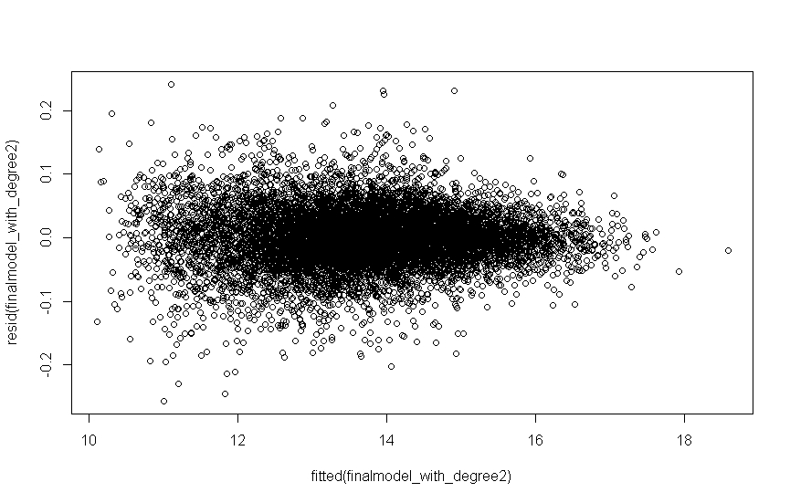
Model validity
Homoscedastic
Q-Q Normal Plot
Very Linear; no normality concerns
Independence test
Durbin-Watson p-value = .246; no correlated residuals concerns
Variance of residuals is constant

Slide 12
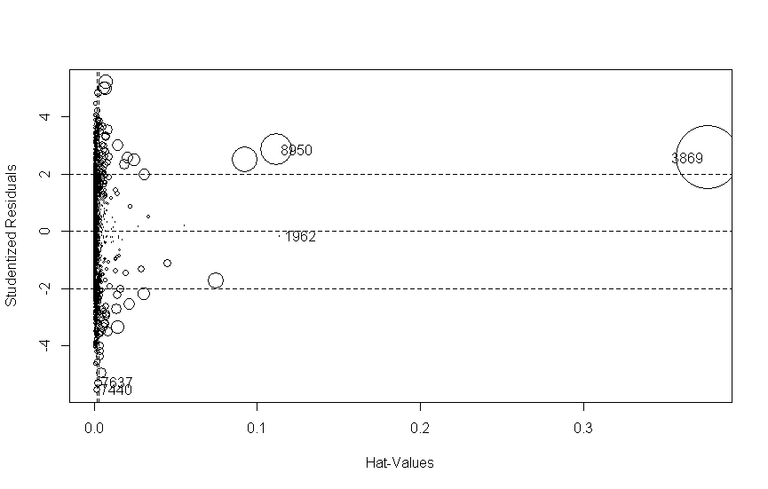
INFLUENCE PLOT

Slide 13
interpretation
Our model predicts that Expected payments from Medicare increases when (assuming all other factors held constant):
Total number of episodes increases
Average number of skilled nursing visits increases per episode
Average number of physical therapy visits increases per episode
Average number of occupation therapy visits increases per episode
Average number of speech therapy visits increases per episode
Average Hierarchical Condition Category (HCC) score of beneficiaries increases
Our model predicts that Expected payments from Medicare decreases when (assuming all other factors held constant):
Total amount claimed by Home Health Agency to Medicare increases

Slide 14

Future direction
Influence Plot Analysis
Recommendations to reduce Medicare costs
Analysis of other variables like region and patient level data

Slide 15

Thank you
Questions?

